Slide 1

Innovative EdTech Platform for Master's Entrance Exam Preparation
We present a unique solution for master's entrance exam preparation, designed to empower students with personalized feedback and real-time support.
Presented By - NextStep Academy

Slide 2

Master's Entrance Exam Preparation: The Challenge
1
Limited Resources
2
Lack of Feedback
Students need targeted, efficient practice materials.
Students need personalized insights and support.
3
Time Constraints
4
Limited Accessibility
Students need to optimize their preparation time.
Solutions should be affordable and available to all.

Slide 3
Our EdTech Solution
Test-Centric Approach
Real-Time Support
Enhanced User Experience
Comprehensive test series and practice exams.
Rule-based chatbot for instant query resolution.
Gamified elements for motivation and engagement.
Adaptive testing technology for personalized learning.
Personalized insights and performance analysis.
Intuitive UI/UX for seamless navigation and accessibility.

Slide 4
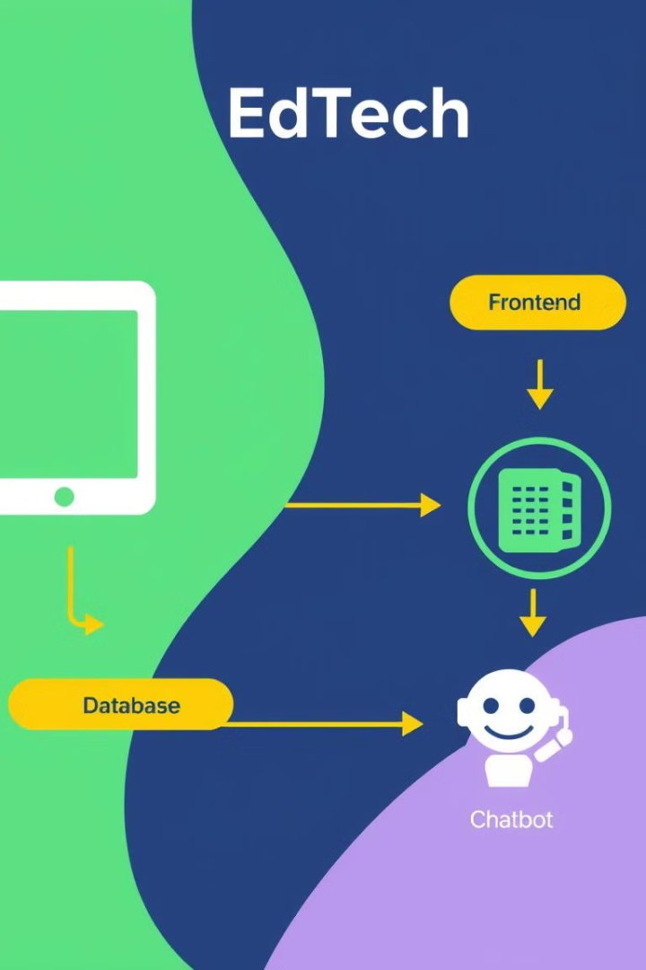




Technical Foundation
Frontend
React.js for a responsive, user-friendly interface.
Backend
Node.js and Express for robust data handling and real-time interaction.
Database
MongoDB for secure and scalable data storage.
Chatbot
Rule-based chatbot for personalized support and insights.

Slide 5

Feasibility and Viability
Feasibility
Viability
Rule-based chatbot for efficient query resolution.
High demand for test-centric platforms with real-time support.
Modular code for easy expansion and customization.
Low operating costs due to minimal server load and resource utilization.

Slide 6





Impact and Benefits
Student Success
Personalized Insights
Improves test performance and builds confidence.
Identifies weak areas and guides study plans.
Engagement Boost
Scalable & Inclusive
Gamified elements and interactive feedback.
Adaptable to various exams and user needs.

Slide 7

The Future of Learning
We envision a future where students can access personalized, effective learning experiences tailored to their needs and goals. We are excited to continue developing our platform, expanding its features and reaching more students on their journey to success.

